Slide 1
Core Types of Work

Slide 2
Calendar Events Repetitive Activities Quality Problems Obstacles
New Artifacts

Slide 3
Calendar Events

Slide 4
Date
Prioritization
Commitment

Slide 5
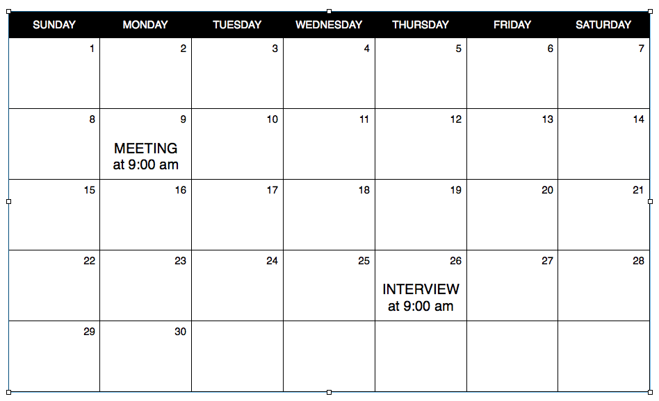
Example
David on Vacation
Marketing
Training
1 - 3

Slide 6
Discussion
Examples in your work
Challenges
How OpenAgile helps
Notes:
Create a list of 10 common obstacles that you face in your life.
Then share with a partner.

Slide 7
Repetitive Activities

Slide 8
Frequency
Event Based

Slide 9
When someone registers for a training, we must send them an invoice.
Example
Notes:
Example: Unable to send or receive business email

Slide 10
Automation/Delegation

Slide 11
Discussion
Examples in your work
Challenges
How OpenAgile helps
Notes:
Create a list of 10 repetitive activities that you face at work.
Then share with a partner.

Slide 12
Quality Problems

Slide 13
Errors
Excellence
Prevention

Slide 14
Example
(don't forgeet... add an example here)
Notes:
This should be a brief open discussion
- encourage the group to think about quality beyond their own type of work
Errors, defects, bugs, dis-satisfied customers
Visible quality problems vs. invisible problems
How do we “build quality in”? How do we avoid quality problems in the first place?

Slide 15
Discussion
Examples in your work
Challenges
How OpenAgile helps
Notes:
Create a list of 10 quality problems that you often face at work.
Then share with a partner.

Slide 16
Obstacles

Slide 17
Collaboration
Asking for Help
Empowerment
Process Facilitator

Slide 18
Example
Tree fallen down across a road
Notes:
Example: Unable to send or receive business email

Slide 19
Discussion
Examples in your work
Challenges
How OpenAgile helps
Notes:
Create a list of 10 common obstacles that you face in your life.
Then share with a partner.

Slide 20
New Artifacts

Slide 21
Unique
Tangible
Negotiable
Creativity
Notes:
New Artifacts may go into another core type of work at some point

Slide 22
Example
A new report
Notes:
Velocity
Capacity
Courage
Cycle Plan

Slide 23
Discussion
Examples in your work
Challenges
How OpenAgile helps
Notes:
Create a list of 10 common obstacles that you face in your life.
Then share with a partner.

Slide 24
O
Notes:
Any questions or comments?

